Slide 1
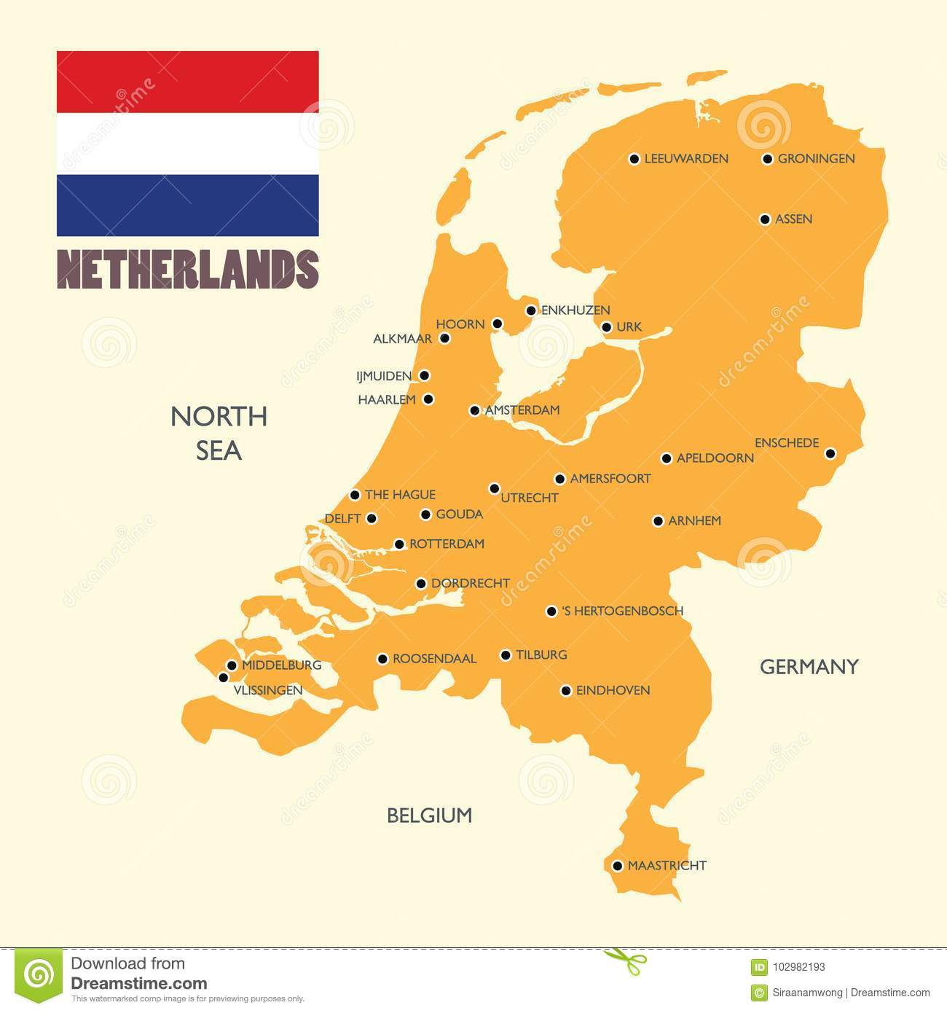
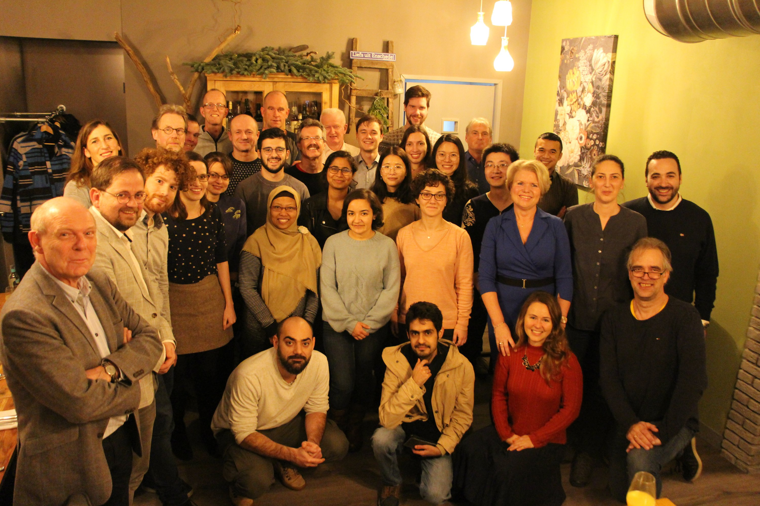
Data management & Biometrics group (DMB)
@University of Twente, Enschede, NL
19 scientific staff 2 technical staff
22 PhDs
Maurice van Keulen

Slide 2
subjects/projects/systems
Mission
autonomous, reliable and robust
gathering, preparation, and analysis of the data
to enable
relevant, trustworthy and explainable results
Machine Learning
Biometrics
Sparsification
Explainable AI
Process Mining
Network DS
Data integr. Data Quality
Computer Vision

Slide 3
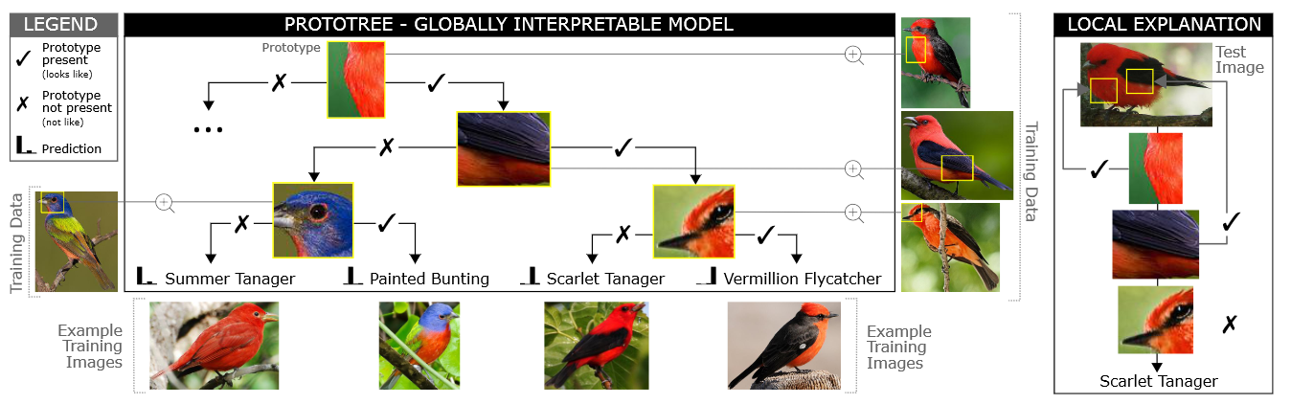
noteworthy
DuBio (PostgreSQL)
DuBio: Probabilistic DBMS Purpose: Prob. Data Integration & Mgmt of DQ problems
AI explainable by design: ProtoTree
DL approach learn a reasoning not just to make a prediction

